Slide 1
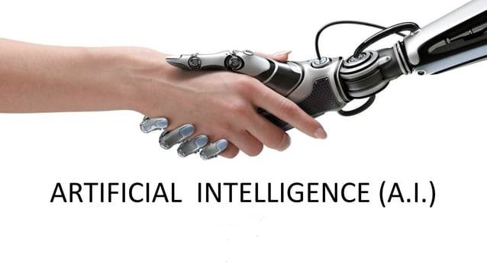
-Presented by Department of CSE Class Id:-(01-05) Subject: English Subject: Eng-102

Slide 2
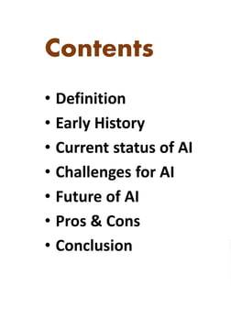
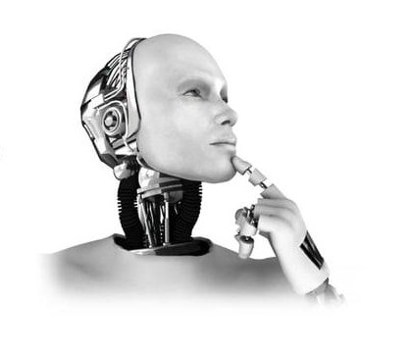

Slide 3
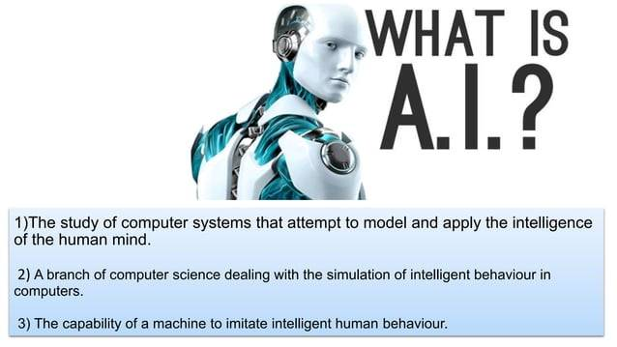

Slide 4
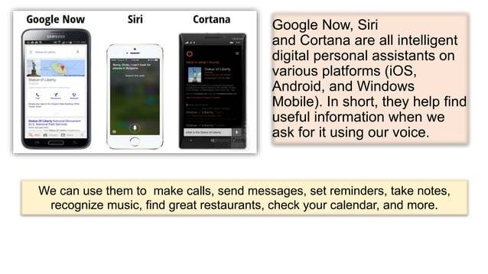

Slide 5
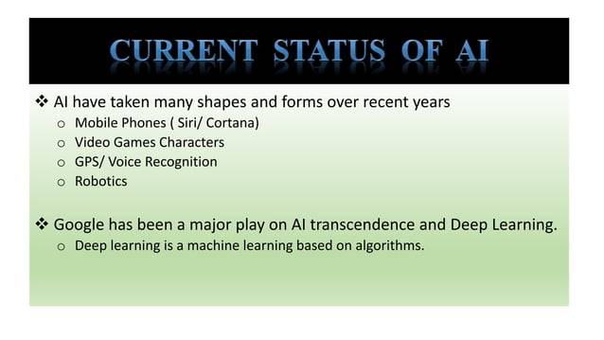

Slide 6
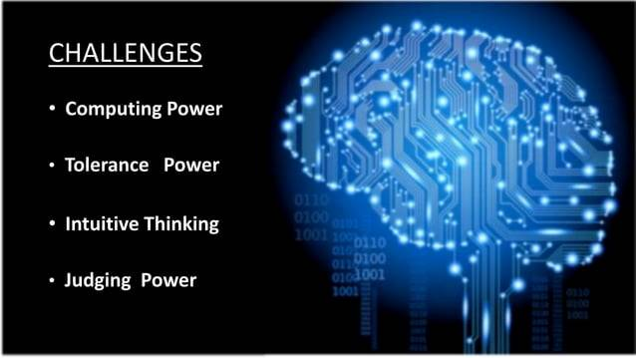

Slide 7
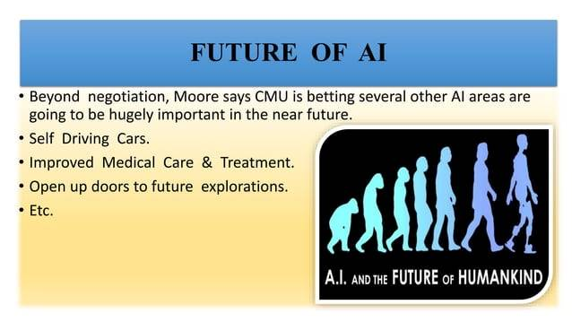

Slide 8

Pros of Artificial Intelligence: | Cons of Artificial Intelligence:
Automation and Efficiency Improved Decision Making Enhanced Accuracy Advanced Problem Solving Innovation and Advancements | Job Displacement Ethical Considerations Lack of Human Judgment and Intuition Reliance on Data and Algorithms Security and Privacy Risks

Slide 9
